Slide 1


Steroid Safety Bundle
A Lothian quality improvement initiative to reduce complications in long term high dose steroid use.
Dr Marcus Lyall
Consultant Physician
Royal Infirmary of Edinburgh

Slide 2
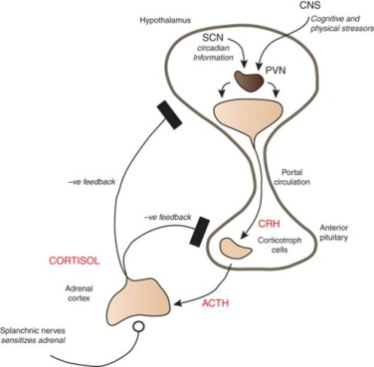
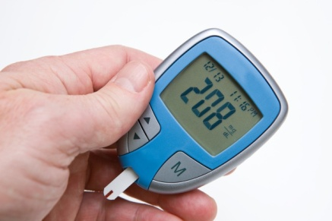
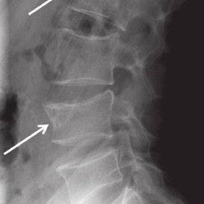

Early Complications – steroid use
Intermediate/Late Complications
Suppression of
hypothalamic pituitary axis
Insulin
Hepatic gluconeogeneis
Glucose
Osteoporosis
Changes in cognition, mood delirium, psychosis.
Proximal myopathy
Axial weakness
falls.
- Mood disorders
Possible changes to gastric blood flow and tissue repair.
- Risk of bleed or perforation (inpatient setting).
Cardio metabolic disorders
Hypertension
Obesity
Insulin resistance
Dyslipiaemia.

Slide 3

Need for a guideline?
Response to serious clinical incidents in Lothian
    Steroid induced severe hyperglycaemia is not uncommon
    Often elderly or vulnerable (boney metastases, inflammatory disorders, respiratory disease)
    High associated morbidity and mortality.
    Occurs in almost all patients with known diabetes or pre-diabetes
    Near total absence of guidance on screening and treatment
Anything else?
    Inconstant guidance around steroid withdrawal.
    Inconsistent implementation of sick day rules. Information difficult to find.
    ? Use of bisphosphonates generally ok
    ? PPI use
Notes:
Guidelines in steroid care ad dispirat
Canvassed colleagues.

Slide 4

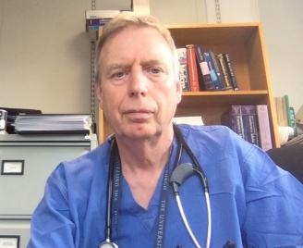
Steroid Safety Bundle:
Dr Lizzy Boyce GP and Specialty doctor in MoE
Dr David Joliffe – GP and chair Diabetes MCN.
Dr Clare Jamieson GP
Dr Tom Chambers consultant physician WGH
Dr Marcus Lyall Consultant Physician RIE
SN Katherine Ramage – Diabetes Specialist Nurse.
Dr Nyo Nyo Tun Consultant Physician RIE
Dr Rachel Williamson consultant physician BGH
Dr Katheryn Linton consultant physician RIE
Professor Mark Strachan. Chair Diabetes MCN and Consultant physician. WGH
Aims:
    Single reference document for screening and treatment multiple steroid induced complications.
      “one stop shop”
      Unambiguous and specific
      concise
    Patient information documents
    Steroid safety cards
Prof Stuart Ralston
Consultant rheumatology
Prof John Plevris
Consultant gastroenterologist

Slide 5
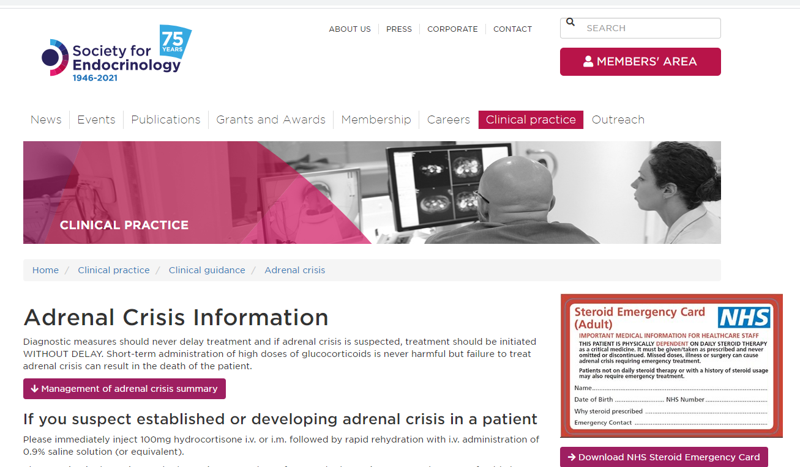
Screening for and treatment of steroid induced hyperglycaemia
Managing steroid withdrawal.
Standardising bisphosphonate use.
Standardising PPI prophylaxis use.

Slide 6
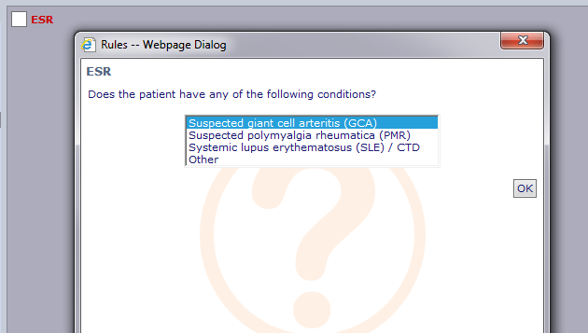
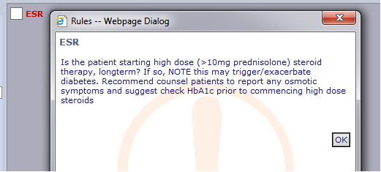
THINGS TO DO AT COMMENCEMENT OF LONG TERM STEROID THERAPY
PERFORM an HbA1c and warn patient of symptoms of hyperglycaemia
GIVE ADVISE ON ‘SICK DAY RULES’ and give STEROID CARD ( both appendix 1)
GASTROPROTECTION.
PPI therapy should not be given routinely but should be considered for people at high risk of gastrointestinal bleeding or dyspepsia. (eg previous GI bleed, known GORD/peptic ulcer disease, currently on anticoagulation or active cancer).
bone protection
Bisphosphate should be considered to prevent vertebral fractures in men and women on prednisolone doses of 7.5 mg daily or greater (or equivalent) for three months or more.
LONG TERM HIGH DOSE STEROID THERAPY = ≥ 10mg prednisolone (or equivalent) for > 14 days
Prednisolone 10mg approx equivalent to
Hydrocortisone 40mg
Dexamethasone 2mg
Methylprednisolone 8mg
Betamethasone 2mg
NHS LOTHIAN STEROID SAFETY BUNDLE VERION 6. Dr M Lyall. Review date 01/08/2024
Notes:
Important to note this is for long term high dose steroid use – not short courses.

Slide 7
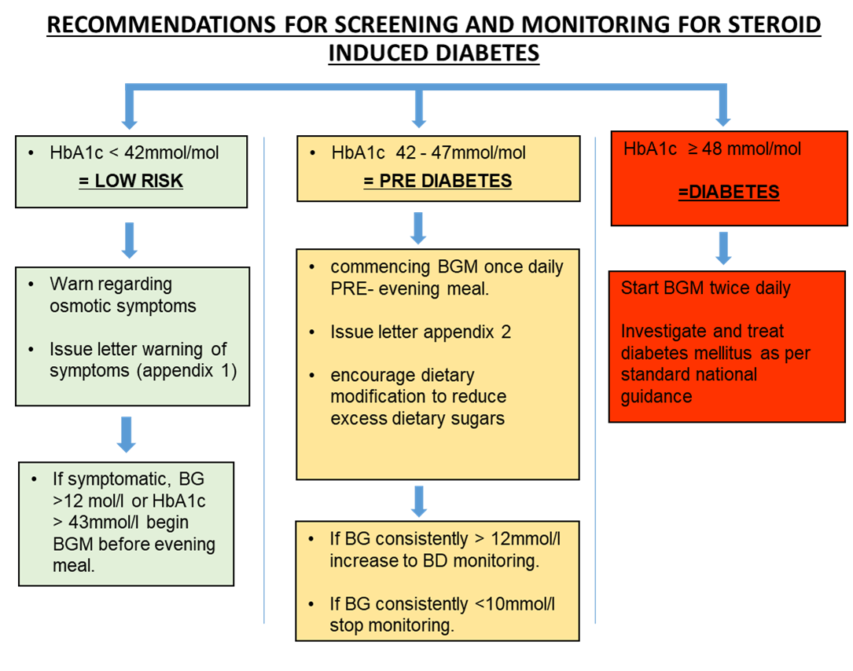
IF ALREADY KNOWN PRE-EXISTING DIABETES MELLITUS
Type 1 Diabetes: ENSURE USING CGM (eg freestyle libre) or blood glucose monitoring QDS AND ADVISE TO CONTACT DIABETES NURSES TO AID TITRATION.
Type 2 Diabetes: INITIATE BGM TWICE DAILY (BEFORE BREAKFAST BEFORE EVENING MEAL) – USE TREATMENT ALGORITHM BELOW
If BG > 12mmol/l on 3 continuous days initiate treatment as per treatment algorithm below
ALL patients on high dose steroid therapy should have a 3 monthly HbA1c
NHS LOTHIAN STEROID SAFETY BUNDLE VERSION 6. Dr M Lyall. Review date 01/08/2024

Slide 8
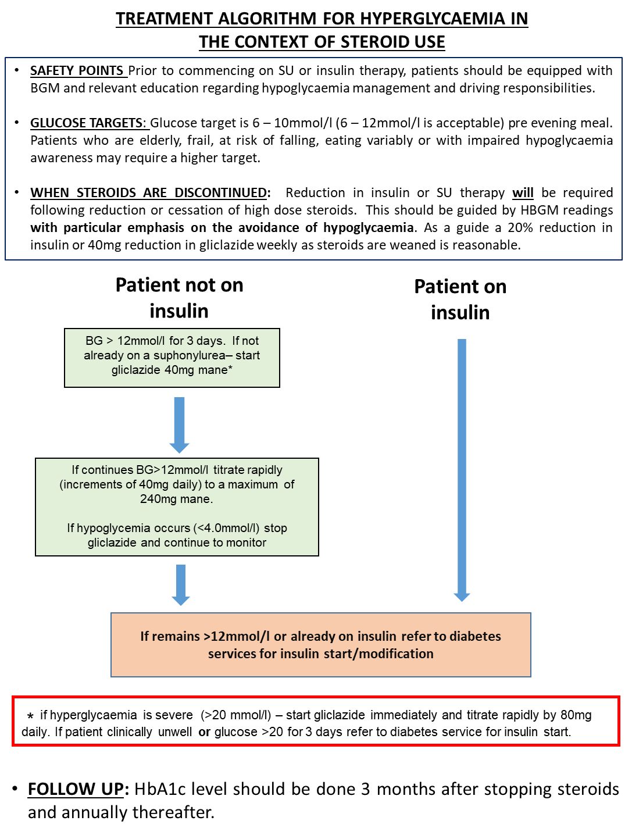
WHEN STEROIDS ARE DISCONTINUED:
Reduction in insulin or SU therapy will be required following reduction or cessation of high dose steroids.
This should be guided by HBGM readings with particular emphasis on the avoidance of hypoglycaemia.
As a guide a 20% reduction in insulin or 40mg reduction in gliclazide weekly as steroids are weaned is reasonable

Slide 9
Steroid Withdrawal
  Adrenal suppression should be considered for all patients who have had more than 3 weeks of >5mg prednisolone or equivalent
  Patients can be risk stratified by a morning cortisol sample taken prior to steroid dose
RISK | AM CORTISOL | ACTION
HIGH RISK | <275 | Continue 4mg prednisolone and refer to endocrinology services. (If already in secondary care, perform short synachten test pre morning steroid dose if possible)
MODERATE RISK | 275 - 425 | Can stop prednisolone Sick day dosing of 10mg prednisolone (or seek medical attention if unable to take) as per steroid safety card for 3 months.
LOW RISK | >425 | Can stop prednisolone.

Slide 11
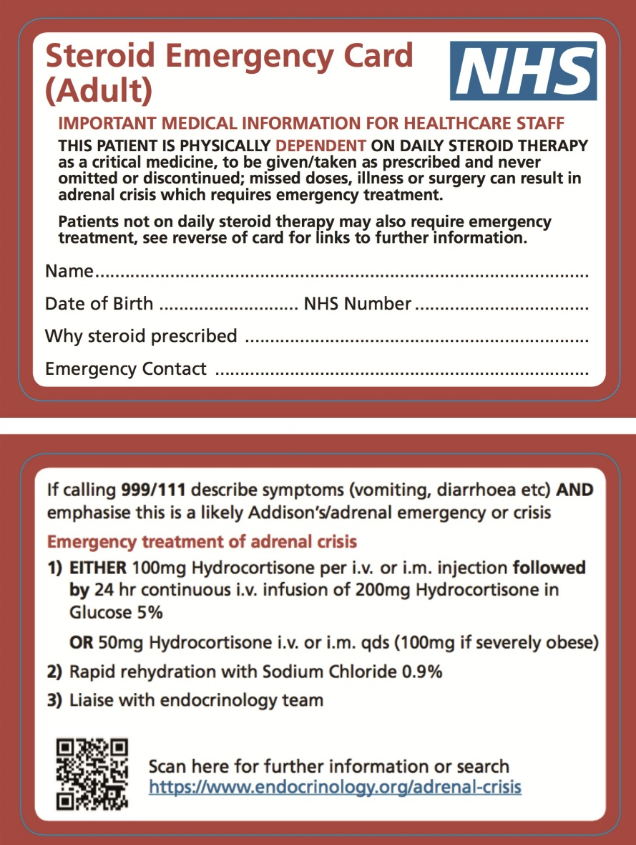
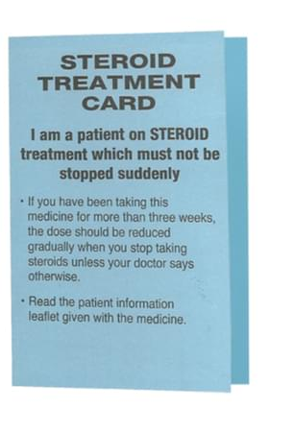
Currently negotiating sustainable funding for print and distribution.
https://www.endocrinology.org/adrenal-crisis

Slide 12
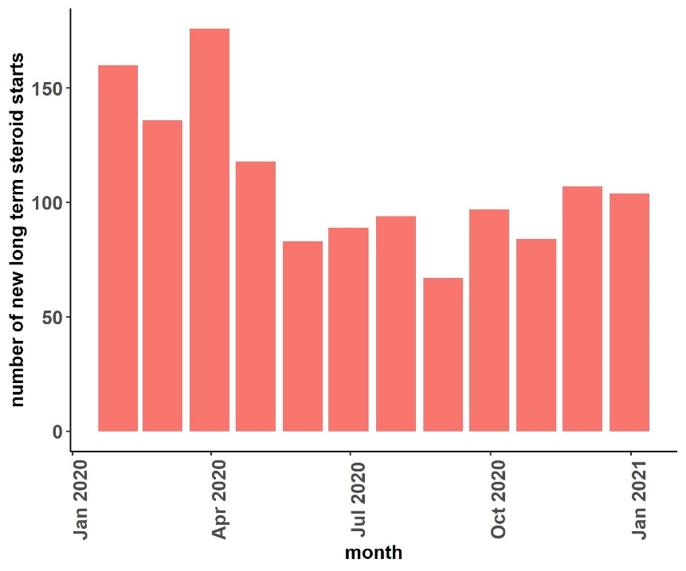
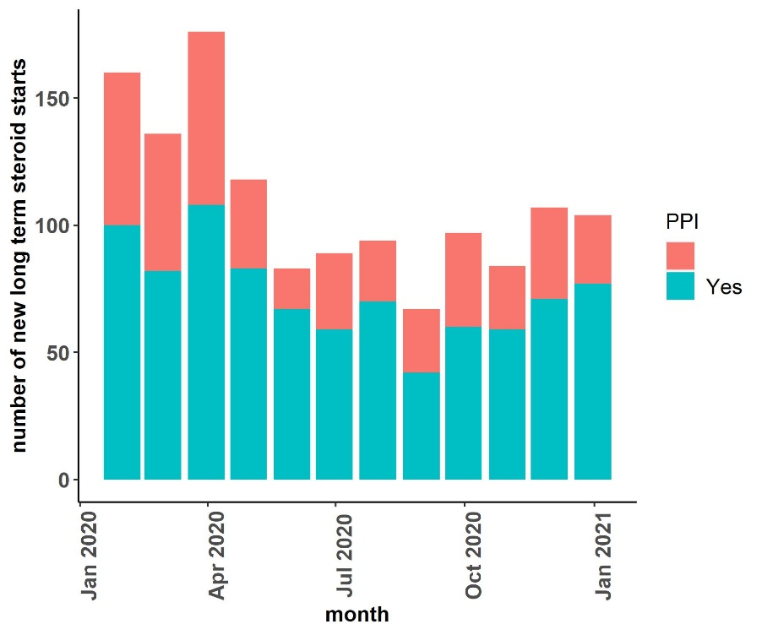
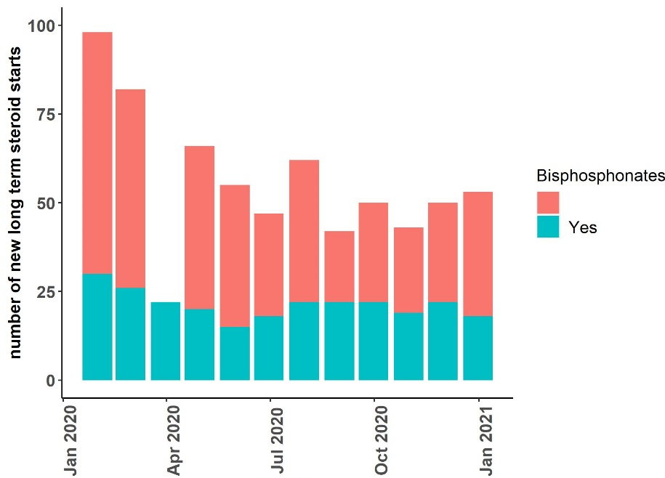
How common is long term steroid use in lothian?
n = 1351
Source: original data from Lothian Prescribing Information Service
Prednisolone, dexamethasone, methylprednisolone containing oral preparations from community pharmacy.

Slide 13
Number of new long term (> 1 month), high dose steroid starts per month Jan – Dec 2020 NHS Lothian
 | Number | Per practice n = 124
January | 160 | 1.3
February | 136 | 1.1
March | 176 | 1.4
April | 118 | 1.0
May | 83 | 0.7
June | 89 | 0.7
July | 94 | 0.8
August | 67 | 0.5
September | 97 | 0.8
October | 84 | 0.7
November | 107 | 0.9
December | 104 | 0.8
TOTAL | 1315 (0.16% pop) | 10.60
Consistent with published UK data
Fardet, Rheumatology, 2008 Volume 50, Issue 11, November 2011, Pages 1982–1990,.
Source: original data from Lothian Prescribing Information Service
Prednisolone, dexamethasone, methylprednisolone containing oral preparations only

Slide 14
Key points:
Steroid induced hyperglycaemia is common with high morbidity particularly in frailty.
HbA1c is a useful screening tool if steroids are likely to be long term (>10mg prednisolong for > 2 weeks).
Treatment with a.m gliclazide is mainstay of therapy.
Adrenal suppression should be considered with > 3 weeks prednisolone >5mg or equivalent. Morning cortisol can be used to stratify withdrawal risk.

