Slide 1
Investigation and management of abnormal liver function tests
Alexandra Thompson

Slide 2
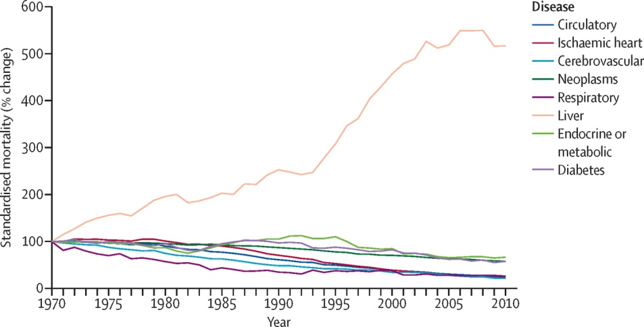
Background
Liver disease is 3rd biggest cause of premature mortality and lost working life behind IHD and self-harm
Most liver disease is preventable
5% deaths attributable to autoimmune/genetic causes
>90% due to alcohol, obesity and viral hepatitis
Williams R, Lancet 2014

Slide 3
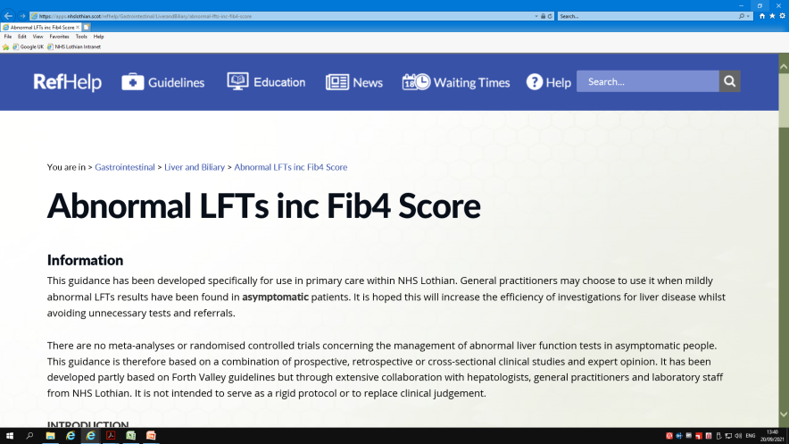
Asymptomatic Abn LFTs
Diagnose the problem
Stage fibrosis
Looking for F3/4, advanced fibrosis/cirrhosis
Presence of cirrhosis identifies those at risk of clinical decompensation and liver-related mortality, and those at highest risk of HCC
Why are we checking LFTs and are there risk factors for liver disease?
Keep in mind principles of realistic medicine
Cirrhosis develops over many years
Fibrosis may not be life-limiting in elderly/comorbid
We should apply NITs to populations with risk factors for liver disease, not unselected populations
Notes:
If apply NITs to unselected populations, get increased range of potential differential diagnoses for positive results

Slide 4
Pathway: ‘Abnormal LFTs including Fib4 score
Patient assessment
History including alcohol intake and medication review
Examination
Investigation
GP order comms/ICE liver screen contents
FBC, LFTs, AST, albumin, INR, glucose, cholesterol, HDL-Chol, total immunoglobulins ferritin - if raised then iron studies (iron, transferrin and transferrin saturations) will automatically be measured by lab³ Fibrosis 4 score – to assess hepatic fibrosis ⁴ Caeruloplasmin – only measured if <55 years Hepatitis serology - HBsAg and anti-HCV Ab Immunology - anti-smooth muscle Ab, anti-mitochondrial Ab, anti-LKM1 and anti-nuclear Ab ⁵ NB: If any of the above tests are felt to not be appropriate for your patient e.g. because they have been measured previously, then please deselect the box for that test when ordering on ICE
History
Alcohol if high, advise abstinence and repeat LFTs Medication see below Hepatitis risks IVDA, sexual history, travel, ethnicity Metabolic syndrome T2DM, obesity, BP, lipids Autoimmune disease T1DM, thyroid, RA Family history
Medication Review
Review medications including OTC and herbal remedies and consider discontinuing any causative drugs. If in doubt, discuss with Hepatology
Examination
BMI Spider naevi, palmar erythema Palpable liver or spleen
Investigations
1. GP order comms (ICE) liver screen 2. Abdominal Ultrasound only if aged > 65 or if referring to secondary care ²

Slide 6
Pathway: ‘Abnormal LFTs including Fib4 score
Hepatology Referral Criteria
Investigations suggest a cause other than alcohol or NAFLD (NB alcohol or NAFLD rarely cause ALT > 300) Evidence of impaired liver synthetic function: ↑bilirubin (not due to Gilberts syndrome) ↑ INR ↓albumin Evidence of possible fibrosis or cirrhosis Fibrosis 4 Score⁴ > 1.3 (age <65) or >2.0 (age>65) Platelets < 150 Diagnosis or management still uncertain
Notes
1 This guideline is for patients who are asymptomatic with persistently deranged LFTs. If acute hepatitis is suspected, request the acute hepatitis panel which adds hepatitis A, Hepatitis E, CMV and EBV.
2 The diagnostic yield for abdominal ultrasound in patients < 65 with no symptoms and only abnormal liver enzymes is extremely low
3 Iron studies (iron, transferrin and transferrin saturations) to assess for iron overload can be carried out on a non-fasted sample but if iron or Tsat raised then iron studies should be repeated on a fasting sample to confirm. If confirmed, elevated Tsats (>45% F, >50% M) suggest possible haemochromatosis and genotyping should be arranged.
4 Fibrosis 4 score, calculated by lab using age, AST, ALT and platelets, stages the disease severity:
Age ≤65: <1.3 suggests no fibrosis
Age >65: <2.0 suggests no fibrosis
All ages: >3.25 suggests advanced fibrosis/cirrhosis.
5 Parietal cell Abs will also be measured as these are carried out alongside liver autoantibody measurement. If positive gastric parietal cell Abs, please see RefHelp interpretive comments.
Guidance to be updated!
Refer to Hepatology if any of the referral criteria are met
Request an upper abdominal ultrasound scan for all secondary care referrals
Use Hepatology (Liver Medicine) at RIE via SCI Gateway: please also use for hepatology advice
If the referral criteria have not been met:
Request an abdominal ultrasound only if aged > 65
The abnormal LFTs are likely to be due to NAFLD or alcohol without cirrhosis
For management of NAFLD see guidance on RefHelp
Guidance to be updated!

Slide 7
Acute hepatitis
Liver disease | Peak aminotransferase level (xULN) | Peak bilirubin (xULN) | Pattern of resolution
Acute viral hepatitis | 10-40 (sustained) 500-2000 | 5-10 100-200 | Usually gradual reduction in ALT/AST
Acute ischaemic injury | >40 (early) >2000 | <5 <100 | Rapid reduction in ALT/AST
Toxic injury | >10 (early) >500 | <5 <100 | Often similar pattern to ischaemic
Acute biliary obstruction | 5-10 (early) 250-500 | 5-10 to >10 | Rapid elevation and fall in ALT/AST typically precedes rise in bili/ALP
Alcoholic hepatitis | 5-10 (sustained) <300 | 5-10 to>10 | Prolonged elevation of ALT/AST. AST:ALT ratio typically >2

Slide 8
Staging fibrosis
No single NIT can be used in isolation to diagnose cirrhosis
Guideline aims to identify individuals in whom we can’t rule out advanced fibrosis, for further testing
Yeoman A, Clinical Liver Disease, 2021

Slide 9
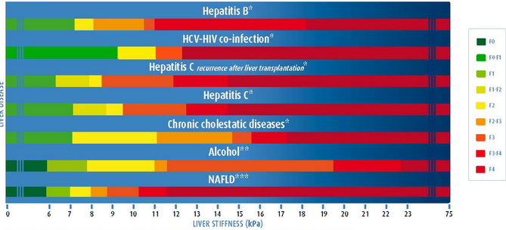
Non-invasive tests
Serum markers
Fib4 (not so accurate >65)
Hyaluronic acid
NAFLD Fibrosis Score
ALT:AST ratio
Transient elastography
Measures liver stiffness
High performance for cirrhosis, AUROC>0.9
Less successful in morbid obesity
Can overestimate fibrosis in inflammation, excess alcohol, obstructive cholestasis, food ingestion, exercise or venous congestion
Also get a measure of steatosis (CAP)
Notes:
Performance of fib4 not quite as good as TE

Slide 10
What not to refer – if referral criteria not met...
ALD/NAFLD
For NAFLD and ALD, prevalence of advanced fibrosis in unselected populations at risk is <5% and <10% respectively
Notes:
Refs 21/22 from EASL guideline

Slide 11
ArLD

Slide 12
Alcohol-related Liver Disease
Screening questions
Macrocytosis, thrombocytopaenia
high GGT, hyperferritinaemia
Start thiamine
Signposting to local services
Family/social support
In-patient detoxification

Slide 13
https://www.shaap.org.uk/downloads/240-covid-advice-for-heavy-drinkers/viewdocument/240.html

Slide 14
Non-alcoholic fatty liver disease
Provide written advice
Weight loss advice and consideration of weight management services
Give goal of 5-10% of weight
Assessment of physical activity and a recommendation
Can signpost to NHS weight loss plan and British Liver Trust NAFLD
Minimise/abstain from alcohol
Assess and manage cardiovascular risk factors
BP
Diabetes
Lipids
Smoking cessation
TE<8kPa reassuring
Suggest repeat NITs 3yrly in patients with early stage and annually with advanced stage

Slide 15
Conclusions
Diagnose cause of abn LFTs and stage fibrosis
Work within principles of realistic medicine
Fib4 ‘gateway’ test for new guidelines
Sequential non-invasive testing
Large proportion of ALD/NAFLD can be managed in the community
Liver screen on ICE will hopefully be user friendly
Dialogue between primary and secondary care is key to identifying liver disease earlier and improving outcomes

Slide 16
Acknowledgements
Alastair MacGilchrist
Sara Jenks
Gareth Evans
Catriona Morton
Ramon Mcdermott
Andrea Lomas
Clare MacRae
Iain Macpherson

